Slide 1
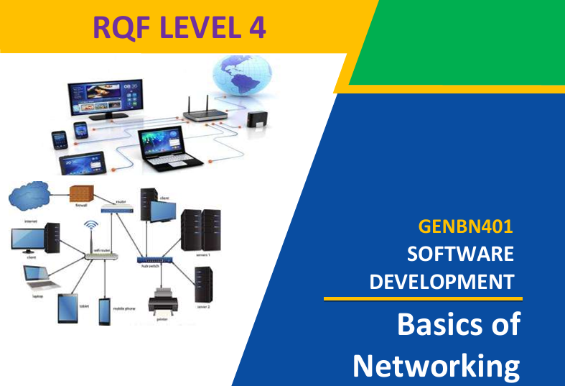
Web application development
Lecture 1
By: Trainer NIZEYIMANA Eraste

Slide 2

1.1.1.: Description of network concepts and technologies
Network: A network is a system of interconnected devices (like computers, phones, printers) that communicate and share resources, data, and services, using physical cables or wireless signals.
The computer on a network may linked through cables, telephone lines, radio waves, satellites, or infrared light beams.

Slide 3
Network classifications/types:
Classifying network by components roles:
Networks can be classified into different categories based on various criteria, including their size, scope, purpose , and architecture.

Slide 4
Some common network classifications:
based on Size:
Personal Area Network (PAN): A small network typically within a range of a few meters, used for connecting personal devices like smartphones, laptops, and tablets.
Local Area Network (LAN): Covers a limited geographic area, such as a home, office, or campus. LANs connect devices like computers, printers, and servers.

Slide 5
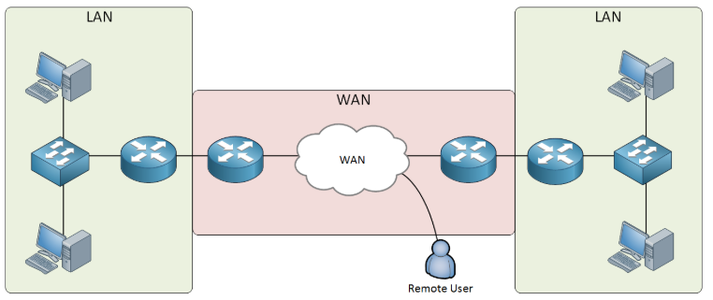
4. Metropolitan Area Network (MAN): Larger than a LAN but smaller than a WAN, covering a city or a large campus. MANs are used by organizations with multiple locations in a city.
5. Wide Area Network (WAN): Connects multiple Local Area Networks (LANs) and devices over large geographical areas (cities, countries) to share resources, data, and applications

Slide 6
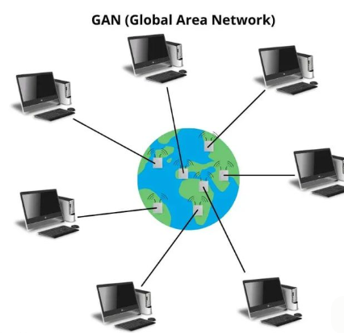
6. Global Area Network (GAN): A network that covers a global or international scale, often using satellite links and undersea cables. The internet can be considered a GAN.

Slide 7
Based on Purpose:
Public Network: Open to the public, such as the internet, where anyone can access and use its resources.
Private Network: Restricted to a specific organization, group, or individuals. Examples include corporate intranets and private cloud networks.
Hybrid Network: Combines elements of both public and private networks, often for security and cost considerations.
Peer-to-Peer (P2P) Network: Devices in this type of network communicate directly with each other without a central server.

Slide 8
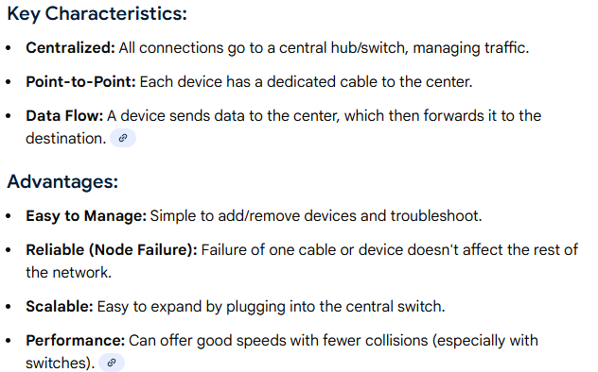
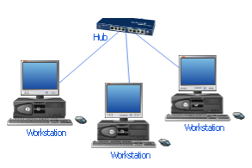
Based on Topology:
Star Topology: Devices connect to a central hub or switch.

Slide 9
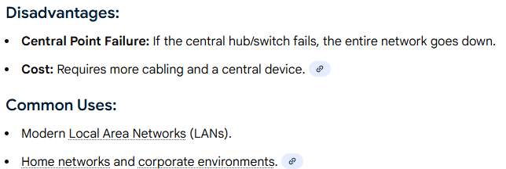

Slide 10
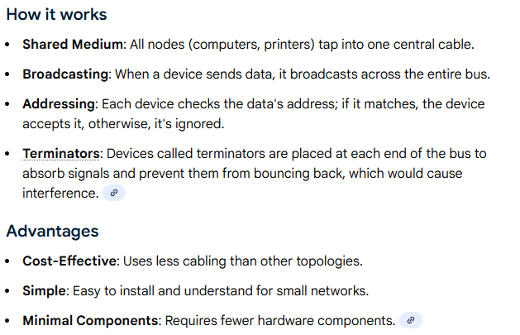
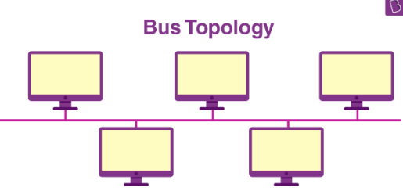
2. Bus Topology: A bus topology is a simple network setup where all devices connect to a single, shared cable

Slide 11
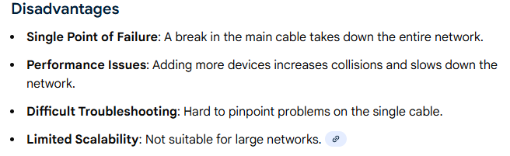

Slide 12
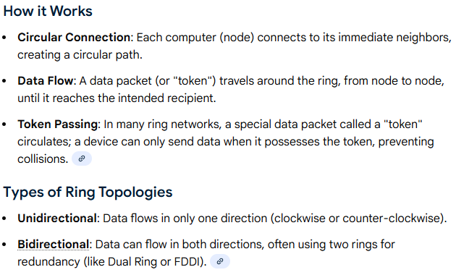
3.Ring Topology: a network setup where devices connect in a closed circle, with each device linked to exactly two neighbors, forming a continuous loop for data to travel

Slide 13


